Slide 1
Generalized Method of Cells
Michael Kaplan
Rehan Nawaz

Slide 2
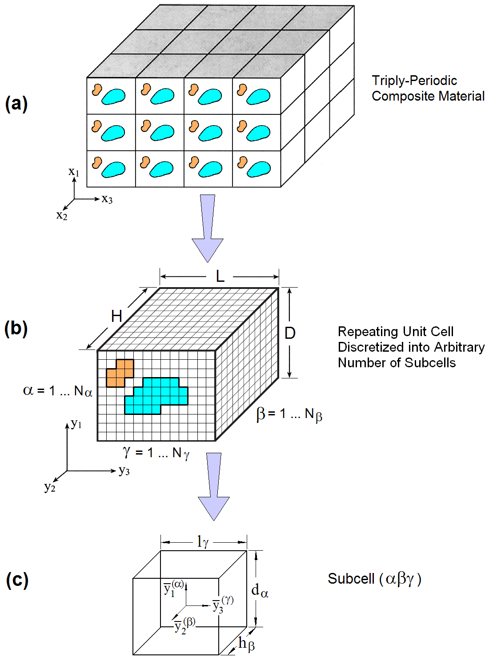
Background
Micromechanics at the constituent level is needed to model composites
Micromechanics takes into account the packing of the fibers
The generalized method of cells is an efficient way of modeling the micromechanics

Slide 3
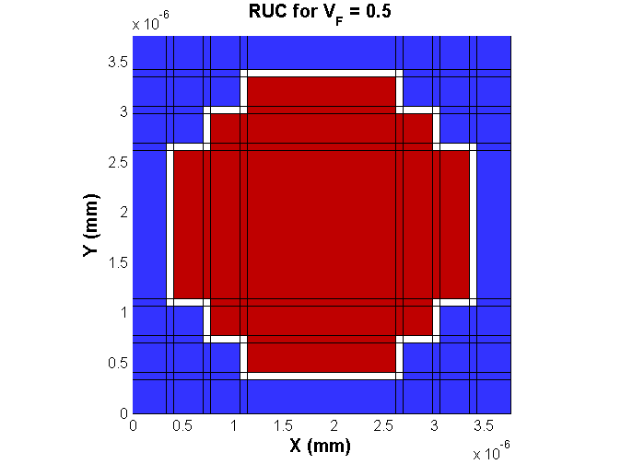
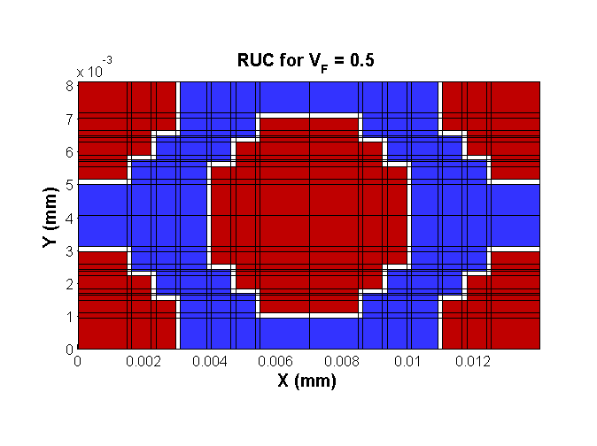
The Method
The RUC is partitioned into rectangular subcells
Many packing structures can be created
Boundary conditions are applied as an average across each subcell boundary
Periodic boundary conditions at the RUC boundaries

Slide 4
The Code
% MOC Input: Hex_0.5_01_AS.moci
% Created: 11-Jul-2014 11:48:03
%
*CONSTITUENTS
NMATS=2
MAT=1,CMOD=1
EA=2.510e+05
ET=4.040e+04
NUA=0.256
NUT=0.321
GA=1.608e+04
GT=3.070e+04
%
MAT=2,CMOD=2
E=3.310e+03
NU=0.318
%
*CELL
AMOD=3
VF=0.500
DF=5.000e-03
%
*LOADING
LMOD=1
NL=1
L=0.00100,
%
*END
The code was written in MATLAB
Code reads an input file and outputs stress, strain, and the C-matrix
Material properties, cell architecture, and loading conditions are set in the input file
Materials are linear elastic and do not have failure conditions

Slide 5
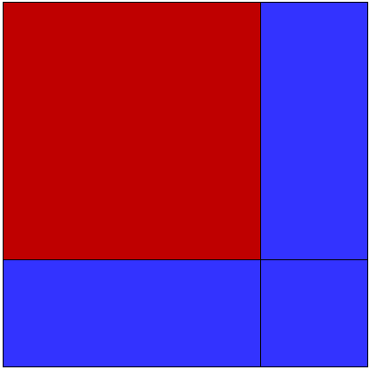
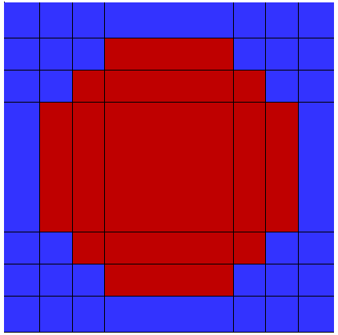
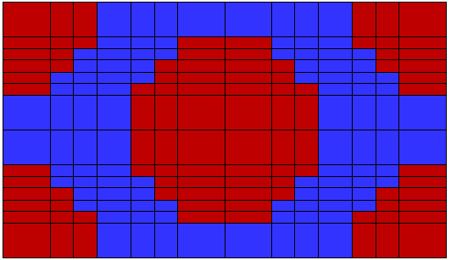
Predefined Architectures
Interphase
Variable volume fraction, fiber diameter, and interphase thickness

Slide 6


Equations
The average stress is equal to the applied strain multiplied by the stiffness matrix.
The stiffness Coefficient in three dimensions is the volume of the RUC multiplied by the elastic stiffness of the RUC times the concentration tensor.
where

Slide 7
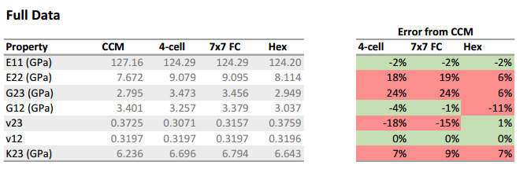
Error Approximation
The Concentric Cylinder Model (CCM) is used to check the accuracy of the MOC code.

